Slide 1
CS 252 Database Management Systems
Jan – May 2020
IV Semester
* Use the slides for reference only. Refer the text book for details.

Slide 2
Additional Relational Operations: Aggregate Functions and Grouping
A type of request that cannot be expressed in the basic relational algebra is to specify mathematical aggregate functions on collections of values from the database.
Examples of such functions include retrieving the average or total salary of all employees or the total number of employee tuples.
These functions are used in simple statistical queries that summarize information from the database tuples.
Common functions applied to collections of numeric values include
SUM, AVERAGE, MAXIMUM, and MINIMUM.
The COUNT function is used for counting tuples or values.

Slide 3
Aggregate Function Operation
Use of the Aggregate Functional operation ℱ
ℱ_{MAX Salary} (EMPLOYEE) retrieves the maximum salary value from the EMPLOYEE relation
ℱ_{MIN Salary} (EMPLOYEE) retrieves the minimum Salary value from the EMPLOYEE relation
ℱ_{SUM Salary} (EMPLOYEE) retrieves the sum of the Salary from the EMPLOYEE relation
ℱ_{COUNT SSN, AVERAGE Salary} (EMPLOYEE) computes the count (number) of employees and their average salary
Note: count just counts the number of rows, without removing duplicates

Slide 4
Using Grouping with Aggregation
The previous examples all summarized one or more attributes for a set of tuples
Maximum Salary or Count (number of) Ssn
Grouping can be combined with Aggregate Functions
Example: For each department, retrieve the DNO, COUNT SSN, and AVERAGE SALARY
A variation of aggregate operation ℱ allows this:
Grouping attribute placed to left of symbol
Aggregate functions to right of symbol
_{DNO} ℱ_{COUNT SSN, AVERAGE Salary} (EMPLOYEE)
Above operation groups employees by DNO (department number) and computes the count of employees and average salary per department

Slide 5
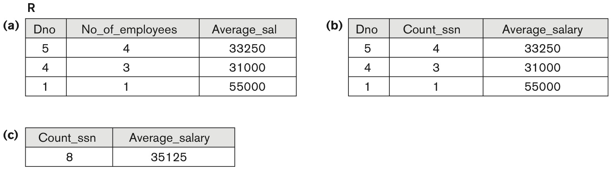
The aggregate function operation
ρR(Dno, No_of_employees, Average_sal)(_{Dno} ℑ _{COUNT Ssn, AVERAGE Salary} (EMPLOYEE)).
_{Dno} ℑ _{alary}(EMPLOYEE).
ℑ _{COUNT Ssn, AVERAGE Salary}(EMPLOYEE).

Slide 6
Additional Relational Operations
Recursive Closure Operations
Another type of operation that, in general, cannot be specified in the basic original relational algebra is recursive closure.
This operation is applied to a recursive relationship.
An example of a recursive operation is to retrieve all SUPERVISEES of an EMPLOYEE e at all levels — that is, all EMPLOYEE e’ directly supervised by e; all employees e’’ directly supervised by each employee e’; all employees e’’’ directly supervised by each employee e’’; and so on.
Although it is possible to retrieve employees at each level and then take their union, we cannot, in general, specify a query such as “retrieve the supervisees of ‘James Borg’ at all levels” without utilizing a looping mechanism.
The SQL3 standard includes syntax for recursive closure.

Slide 7
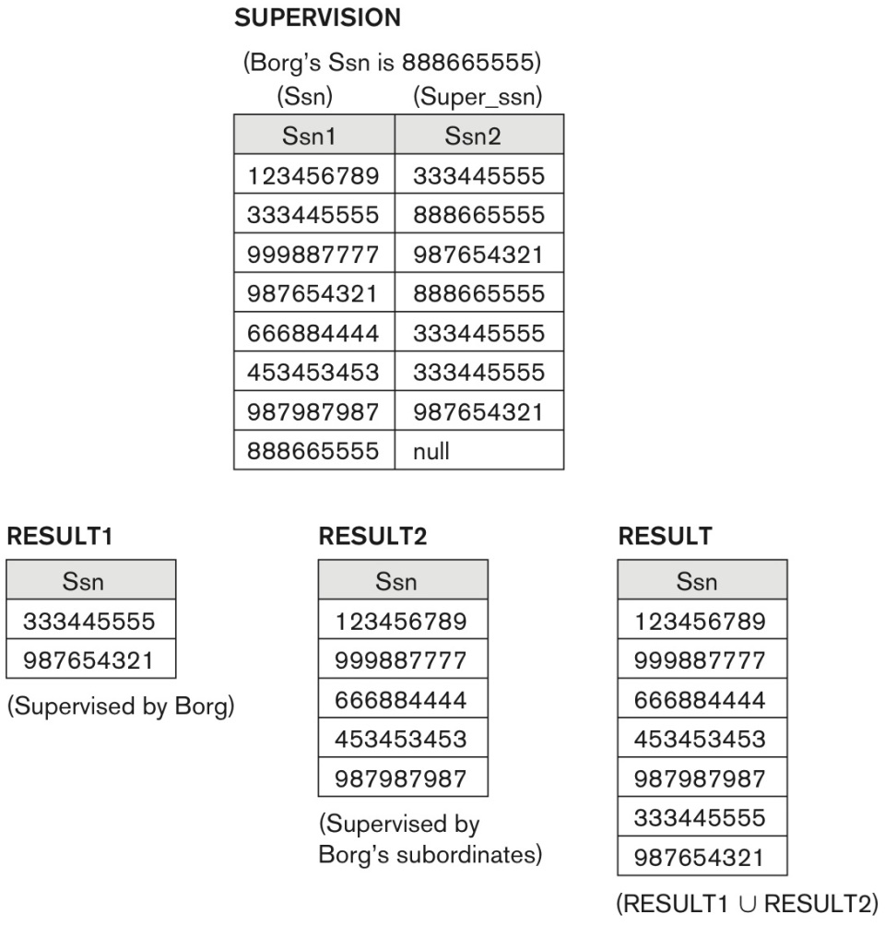
A two-level recursive query.

Slide 8
Additional Relational Operations
OUTER JOIN Operation
In NATURAL JOIN and EQUIJOIN, tuples without a matching (or related) tuple are eliminated from the join result
Tuples with null in the join attributes are also eliminated
This amounts to loss of information.
A set of operations, called OUTER joins, can be used when we want to keep all the tuples in R, or all those in S, or all those in both relations in the result of the join, regardless of whether or not they have matching tuples in the other relation.

Slide 9
Outer join
The left outer join operation keeps every tuple in the first or left relation R in R S; if no matching tuple is found in S, then the attributes of S in the join result are filled or “padded” with null values.
A similar operation, right outer join, keeps every tuple in the second or right relation S in the result of R S.
A third operation, full outer join, denoted by keeps all tuples in both the left and the right relations when no matching tuples are found, padding them with null values as needed.

Slide 10
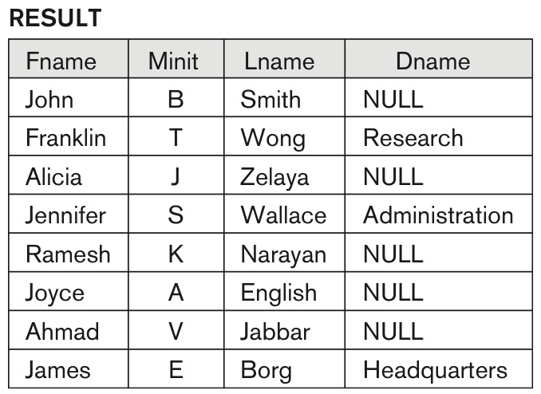
Result of a LEFT OUTER JOIN operation

Slide 11
Outer join
OUTER UNION Operations
The outer union operation was developed to take the union of tuples from two relations if the relations are not type compatible.
This operation will take the union of tuples in two relations R(X, Y) and S(X, Z) that are partially compatible, meaning that only some of their attributes, say X, are type compatible.
The attributes that are type compatible are represented only once in the result, and those attributes that are not type compatible from either relation are also kept in the result relation T(X, Y, Z).

Slide 12
Outer join
Example: An outer union can be applied to two relations whose schemas are STUDENT(Name, SSN, Department, Advisor) and INSTRUCTOR(Name, SSN, Department, Rank).
Tuples from the two relations are matched based on having the same combination of values of the shared attributes— Name, SSN, Department.
If a student is also an instructor, both Advisor and Rank will have a value; otherwise, one of these two attributes will be null.
The result relation STUDENT_OR_INSTRUCTOR will have the following attributes:
STUDENT_OR_INSTRUCTOR (Name, SSN, Department, Advisor, Rank)

Slide 13
Examples of Queries in Relational Algebra : Procedural Form
Retrieve the name and address of all employees who work for the ‘Research’ department.
RESEARCH_DEPT ← σ DNAME=’Research’ (DEPARTMENT)
RESEARCH_EMPS ← (RESEARCH_DEPT _{DNUMBER= DNOEMPLOYEE}EMPLOYEE)
RESULT ← π FNAME, LNAME, ADDRESS (RESEARCH_EMPS)
Retrieve the names of employees who have no dependents.
ALL_EMPS ← π SSN(EMPLOYEE)
EMPS_WITH_DEPS(SSN) ← π ESSN(DEPENDENT)
EMPS_WITHOUT_DEPS ← (ALL_EMPS - EMPS_WITH_DEPS)
RESULT ← π LNAME, FNAME (EMPS_WITHOUT_DEPS * EMPLOYEE)

Slide 14
Examples of Queries in Relational Algebra – Single expressions
As a single expression, these queries become:
Retrieve the name and address of all employees who work for the ‘Research’ department.
π _{Fname, Lname, Address} (σ Dname= ‘Research’
(DEPARTMENT Dnumber=Dno(EMPLOYEE))
Retrieve the names of employees who have no dependents.
π _{Lname, Fname}((π _{Ssn} (EMPLOYEE) − ρ _{Ssn} (π Essn (DEPENDENT))) ∗ EMPLOYEE)

Slide 15
Query Tree Notation
Query Tree
An internal data structure to represent a query
Standard technique for estimating the work involved in executing the query, the generation of intermediate results, and the optimization of execution
Nodes stand for operations like selection, projection, join, renaming, division, ….
Leaf nodes represent base relations
A tree gives a good visual feel of the complexity of the query and the operations involved
Algebraic Query Optimization consists of rewriting the query or modifying the query tree into an equivalent tree.

Slide 16
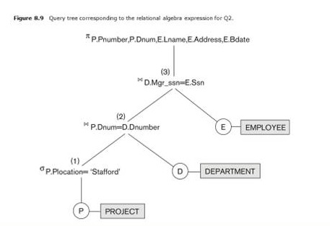
Example of Query Tree
SELECT Pnumber,
Dnum,
Lname,
Address,
Bdate
FROM PROJECT,
DEPARTMENT,
EMPLOYEE
WHERE Dnum = Dnumber AND
Mgr_ssn = Ssn AND
Plocation = ‘Stafford’

